Slide 1
ARMY ROTC COLLEGE OPPORTUNITIES
USACC

Slide 2

What is Army ROTC?
Largest officer generating PROGRAM- Produces over 75% of Army Officers, currently over 30,000 students are enrolled
275 programs nationwide, including Puerto Rico and the Virgin Islands
ROTC offers the same professional opportunities as WEST POINT

Slide 3
COLLEGE SENIOR HIGH SCHOOL
ROTC JUNIOR ROTC
DEVELOPS THE FUTURE LEADERSHIP
OF THE US ARMY
MAKE BETTER CITIZENS
JROTC Not Required for SROTC – helps to learn military structure, ranks, wear of uniform, drill, etc

Slide 4
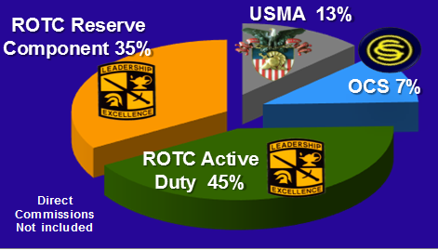
Sources of Officer Commissions

Slide 5
USMA
Please visit the US Military Academy at West Point site for application information:
https://www.westpoint.edu

Slide 6
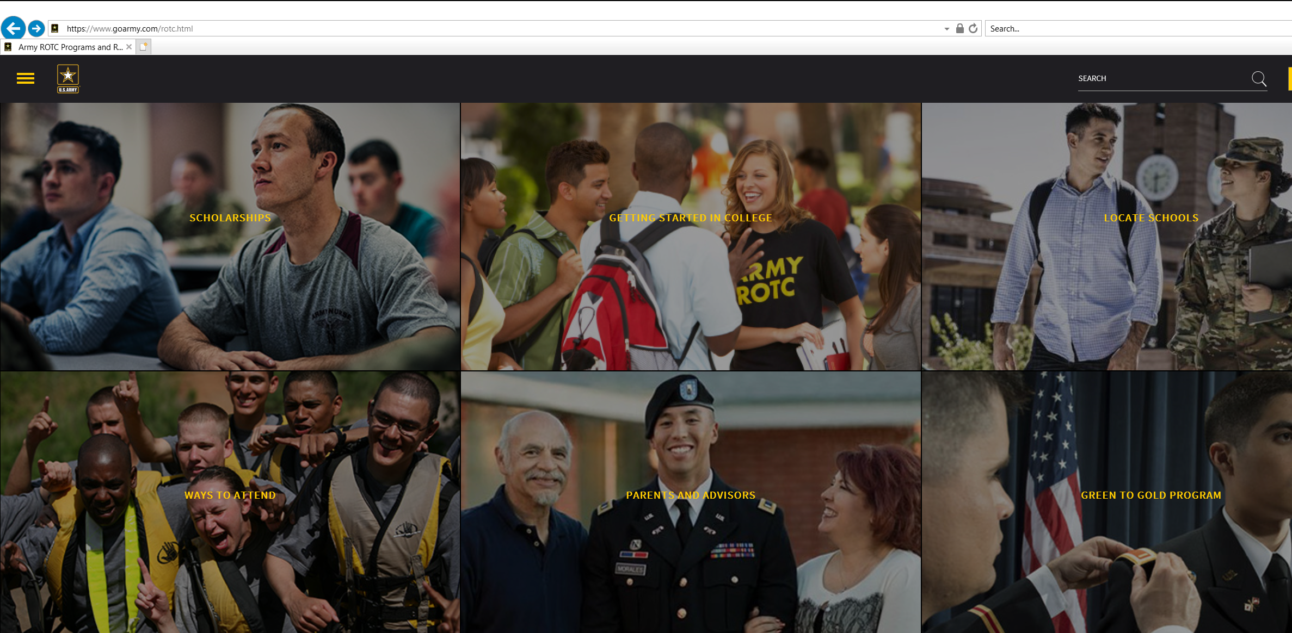
ROTC
Army ROTC | goarmy.com
CLICK HERE !!

Slide 7
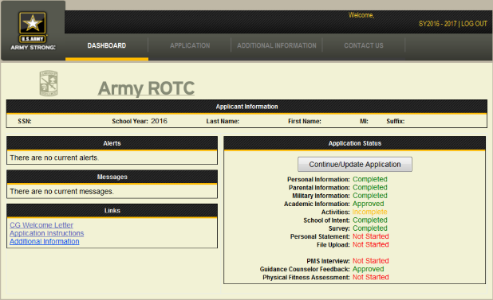
Application Dashboard
Notes:
- This page is called your “Dashboard.” It will show your current completion status for each of the application sections. You will also get alerts and messages here such as the message telling you to contact a school to conduct your interview.
- You do not have to interview at the school where you want to attend. The school closest to you is fully capable to provide you a fair and quality interview.
- Please review the links in the links section. There’s a ton of great information there that will likely answer most of your questions. If you still have questions, use the USARMY.KNOX.USACC.MBX.TRAIN2LEAD@MAIL.MIL email to get answers.
- Click on the grey “Continue/Update Application” to continue.

Slide 8
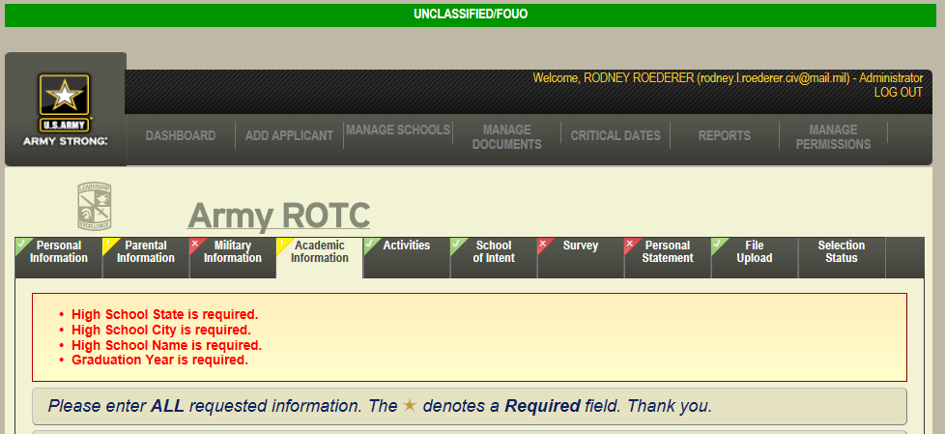
Application
The tabs above show status and allow easy navigation of application areas
Any errors and/or messages on the page will be reflected here
Notes:
- The tabs above show status and allow easy navigation of application areas
- The items in red will let you know there’s still information that needs to be completed.
- The red x tabs have information that is still required, the yellow exclamation marked tabs still need attention, but the green checks are complete.
- The Selection Status tab will let you know where you application is in the process.

Slide 9
COMMON QUESTIONS
PRIVATE COLLEGE VERSES PUBLIC
HOW TO SELECT A COLLEGE AS A SCHOOL OF CHOICE
UNIVERSITY ROTC OML PROCESS
REQUIREMENTS TO MAINTAIN SCHOLARSHIP
PMS INTERVIEW
NATIONAL BOARD COMPRISED
WORK VERSES ACTIVITES
SCHOLARSHIP APPLICATION AND UNIVERSITY ADMISSIONS SEPARATE
MEET RECRUTING OFFICERS LOCALLY AND INTEGRATE
MINUTEMAN SCHOLARSHIPS-CASA-USAR AMB-TAG
1000 4 YR- 1000 3AD (ADVANCED DESIGNEE) NATL OFFERS

Slide 10
JROTC Synergy
SAI’s have responsibility to brief school on SROTC
Contact 6th BDE S2 for questions

Slide 11
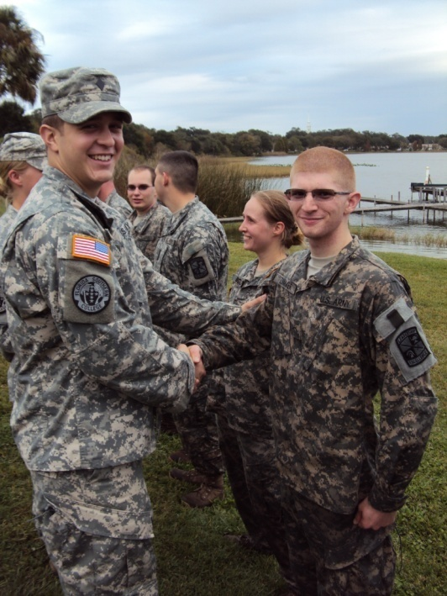
Army ROTC Scholarships
Pays full tuition and fees OR $10,000 for
room and board
$1200 a year book payment
($600 per semester)
Cadet Stipend $ monthly
Some ROTC programs offer additional incentives such as free room and board scholarships (typically private colleges)
Same benefits for those who choose full time career and part time career

Slide 12
High School Scholarship
Application Timeline (for any School Year)
CC Determines
Allocations
12 Jun Application
Window Opens
Prospect JR YR
1st
Board Document submit deadline
2d
Board
3d
Board
4YR On Campus Campaign
Once the student creates an application, these dates can also be found on the page where the login to access their application. They can also be found, once they login, in the Additional Information section under Key Dates.
Prospect SR YR
4 Feb Application
Window Closes
Final selection board. Winners are typically notified between 2-3 weeks after the board
Notes:
The important concept to remember is that USACC is always working one FY out. As this example shows, USACC is offering scholarships with FY 09 funding in FY 08. So the application window opens in the Junior Year for Cadets entering college in the following FY.
The Allocations are determined 18 months before the scholarships recipients arrive on campus. This process remains unchanged. CC sends down an allocation plan to the BDE’s. The BDE’s in-turn make adjustments based on missions and markets of opportunity. BDE’s submit completed allocation plans with UFRs to CC to be loaded in CCIMS. Allocations will be broken down with 80% going to the centralized selection board and 20% for the PMS to award after the application window closes.
June the first interview cycle is run. Interviewees are given 5 schools with the closest zip code to their HOR.
Boards are conducted each month between September and April minus December. Applicants will be boarded only once and given an OML score, if not selected in that board, their file is re-inserted in to the OML’s of subsequent boards until they are selected, or the board cycle is complete. Once selected as a winner the applicant has 30 days to respond that he will take the scholarship and identify where he intends to use it.
Once the application window closes the PMS can begin awarding their 20% of the allocations. The primary use of those allocations is for someone who missed the application window, did not complete their application or who was not selected by the board for a scholarship.
On 1 May applicants are required to confirm their school of choice. No reply will be considered no change from school they identified.
Once all boards are complete and all acceptances are in, CC will evaluate funds available for on campus offers and schools can begin making offers.

Slide 13
ROTC Scholarships
We are the largest grantor of college scholarships in the United States
Scholarships can be for 2, 3, or 4 years (competitive)
  Money can be for tuition or room & board (not both by law)

Slide 14
Whole Person Score
1400 Points

Slide 15
Scholarship Program
Winner Profile – Mission Set 2019
Percentage 2016 2017 2018 2019
Top 5% of Class 48% 44% 41% 21%
Top 25% of Class 85% 82% 78% 69%
Top 50% of Class 97% 97% 95% 94%
Presidents of Student Body or Sr. Class 15% 16% 7% 9%
Other Class Officers 39% 43% 29% 27%
National Honor Society 49% 49% 56% 57%
Varsity Letter Winners 80% 82% 65% 90%
Varsity Team Captains 60% 61% 45% 60%
Club Presidents 7% 7% 15% 17%
JROTC Participants 26% 28% 27% 32%
4 Year College Board Mean 1267 1253 1247 1246
National College Board Mean 1010 1010 1010 1010
High School GPA 3.7 3.6 3.6 3.6

Slide 16
Opportunities
Competitive Salaries
In the Army you garner:
The appreciation of our Nation
A competitive salary
World-wide travel and assignments
100% Medical and Dental coverage
30 days paid vacation annually
Unmatched life insurance
Transferable education benefits
Civilian transition assistance
World-class family services
Highly coveted civilian skills
Rank | Years of Service | Annual Pay
Lieutenant | 2 | $62,095
Captain | 6 | $82,951
Major | 16 | $107,824
Lieutenant Colonel | 20 | $122,797
Colonel | 24 | $142,489
Pay source is http://militarypay.defense.gov/mpcalcs/Calculators/RMC.aspx using avg housing allowance
Notes:
- Military service continues to be a respectable and needed means for giving back to one’s country. Just watch the public support our Soldiers receive as they go through airports in uniform.
-As you can see on the table on the right, pay raises designed to ensure the viability of the All-Volunteer Force have resulted in very competitive wages for commissioned officer service. These figures do not include a tax-free housing allowance based on location and rank.
- In fact, officership offers immediate attainment of middle class status.
- Officers continue to have opportunities to travel and move often to a variety of world- wide locations.
- Generous retirement. 50% of base pay at 20 years of service, rising 2.5% to 75% at 30 years. Annual cost of living allowance raises tied to inflation make it the gift that keeps on giving.
- Service member’s Group Life Insurance (SGLI). All Service Members entitled to $400,000 benefit are automatically insured for the maximum amount of $400,000 for $27/month.
- The new Post-9/11 GI Bill offers up to 100% tuition and fee coverage as well as monthly housing stipend. The Bill also offers a new twist— you have the option of passing on your benefits to your spouse or children.
- The leader training and opportunities you receive will be valuable experience that will hold you in good stead for any career option you pursue following military service.
- According to headhunters, human resources executives, and business school admissions officers, junior officers, with a college degree and leadership experience far beyond that of their civilian peers- are stars waiting to happen.

Slide 17
Questions?
For more Information go to http://www.goarmy.com/rotc/
or contact nearest College Army ROTC Recruiting Operations Officer (ROO)

